Slide 1
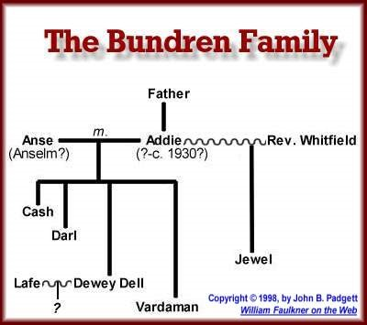

Slide 2
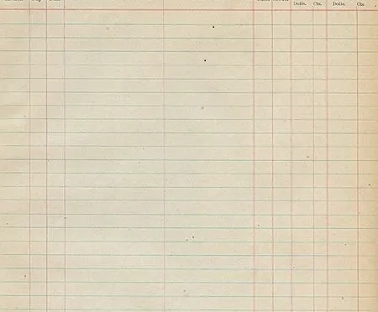

Mrs. Bundren 5 Children
30 years of home and farm labor
Loan of two spades
Graphophone
Cash $8
coffin
Darl $3 job - years of war service
Jewel horse
$3 job
Vardaman fish
Dewey Dell housework
milking
cotton picking
$10
Lafe cotton picking
Peabody repeated medical care
loan of money to pay the hotel
Tull help with corn harvest
help with coffin
guarantee against Peabody’s team/buggy
-not his mule at the river
Samson, Armstid, Gillespie neighborliness
“He’s took care of Anse a long time, now.”
“I reckon He’s like everybody else around here . . . He’s done it so long now He cant quit” (89).

Slide 3
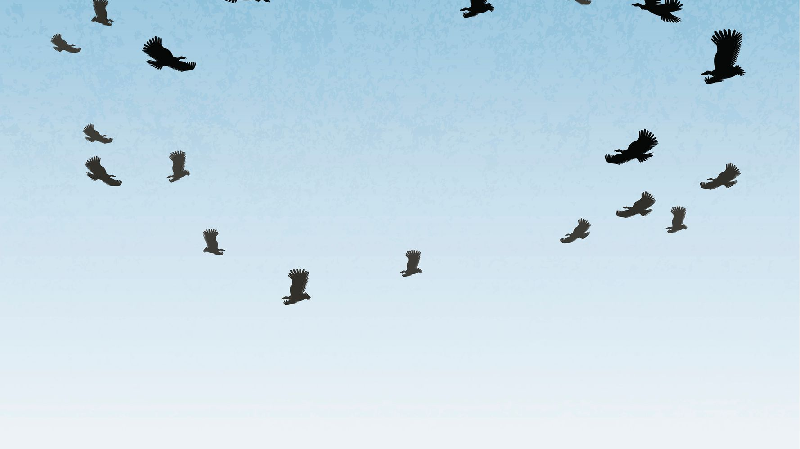
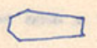
Robert Penn Warren of Faulkner’s writing style:
“His movement has not been linear, but spiral, passing over the same point again and again, but at different altitudes.”*
“Motionless, the tall buzzards hang in soaring circles, the clouds giving them an illusion of retrograde” (95).
“And them circling and circling for everybody in the country to see” (186-87).
“And now them others sitting there, like buzzards. Waiting, fanning themselves” (15).
“I thought at first it was one of them got left, then I saw what it was. It was a buzzard. It looked around and saw me and went on down the hall, spraddle-legged, with its wings kind of hunkered out, watching me first over one shoulder and then over the other, like a old baldheaded man” (118-19).
*The same view we have when we look at the DY map of AILD

